Slide 1

Real Time Face Mask Detection
CS523 Deep Learning Project
Team 4:
Ding Ma, Dingjie Chen
Boston University
August 12th, 2021

Slide 2



The Challenge
Since 2020, COVID-19 has swept the world. Wearing masks has become an essential part of people's access to a public space. Though the time of COVID-19, it is necessary to build a model that detects people with and without mask in real-time. It works as a simple precautionary measure help to prevent the spread of virus.
Notes:
The background of our project is
Since 2020, COVID-19 has swept the world. Wearing masks has become an essential part of people's access to a public space. Though the time of COVID-19, it is necessary to build a model that detects people with and without mask in real-time. It works as a simple precautionary measure help to prevent the spread of virus.

Slide 3

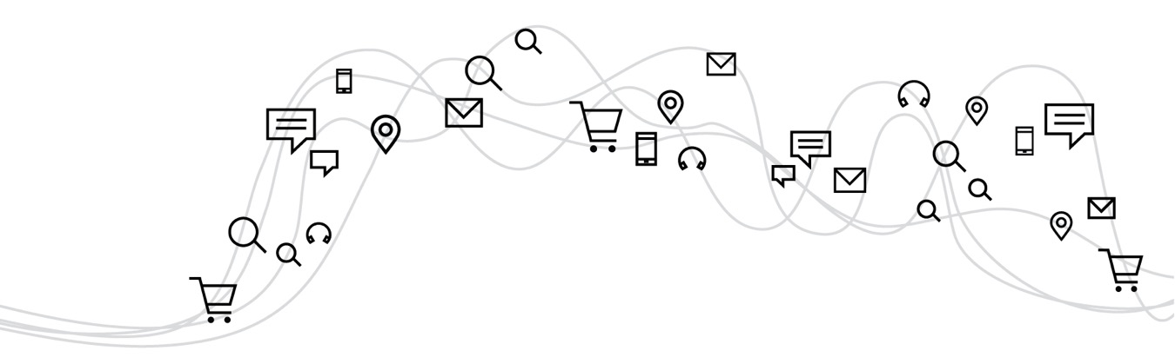
Project Objectives
Build a real time face mask detection system that can detect whether or not people are wearing masks in public space with high accuracy and low lags.
‹#›
Notes:
Our main goal of this project is to build a real time face mask detention system with higher accuracy and lower lags.

Slide 4

Methodology
Image data augmentation
OpenCV face recognition package
CNN classification model
Model Merging
Notes:
The methodology we use to achieve our goal is Image data augmentation, OpenCV face recognition, cnn classification and model merging.
Image data augmentation is used to deal with data size unbalance since there are more data with people not wearing mask than people wearing mask.
OpenCV face recognition package is used to extract human face from images.
Then, we use different CNN models to classify these face into two category
.Finally we use Model merging to combine all the CNN models and choose the highest score to improve the accuracy.

Slide 5
System Pipeline

Slide 6
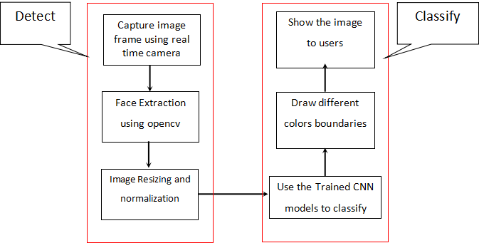
Notes:
In this project, we build a real time face mask detection system that can recognize human faces and classify whether the person is wearing a mask or not. The system’s pipeline is shown above.
The whole system contains two stages, detection and classification.
The first stage is to detect human faces showing in the current frame. And then chop off the faces and resize them to predetermined size.
The second stage is to feed the detected faces into the model trained to sort whether the input face is wearing a mask face or not.
Then, if anyone in the video stream is not wearing a protective mask, a Red coloured rectangle is drawn around the face with a dialog entitled as NO MASK In opposite, a Green colored rectangle will be drawn around the face .

Slide 7
Data Set Analysis and Preparation

Slide 8
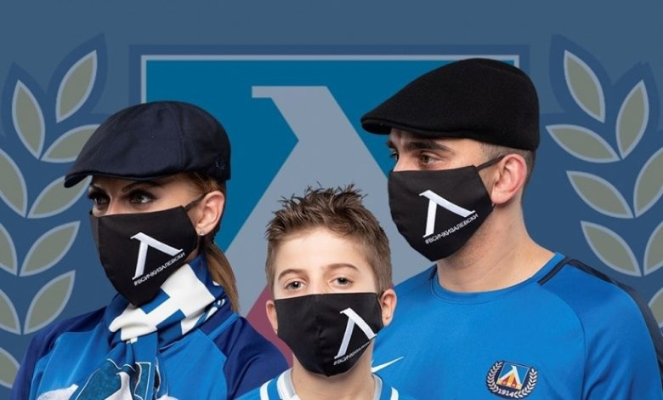
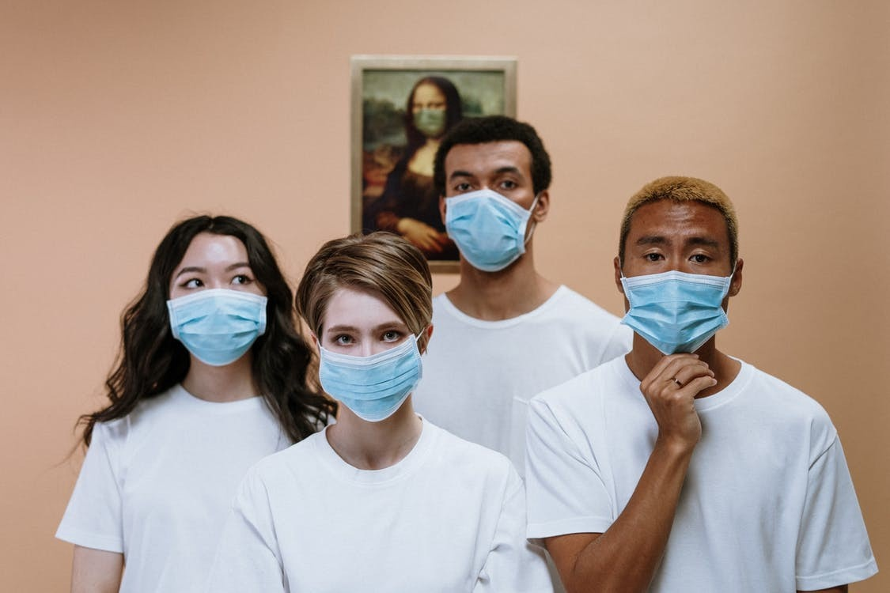
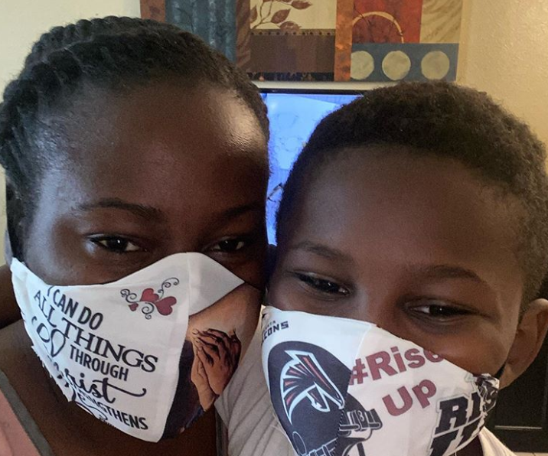
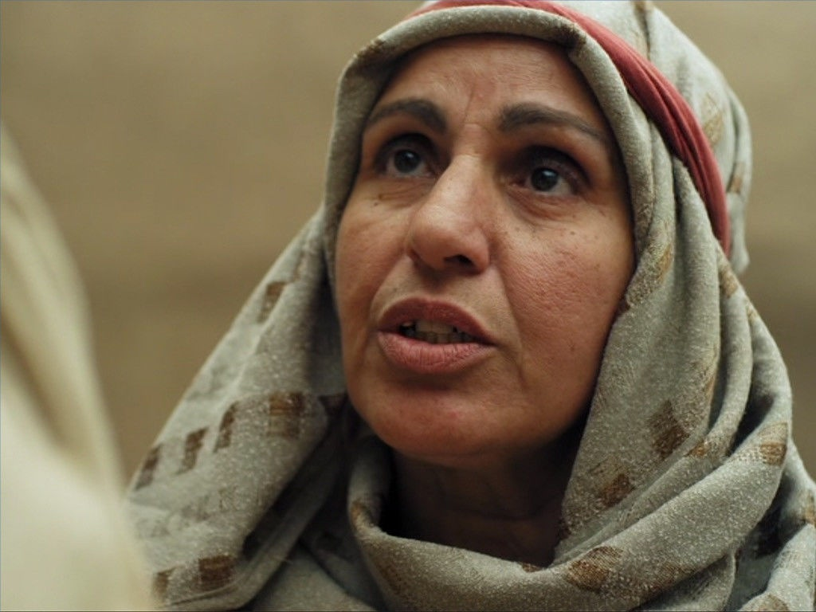
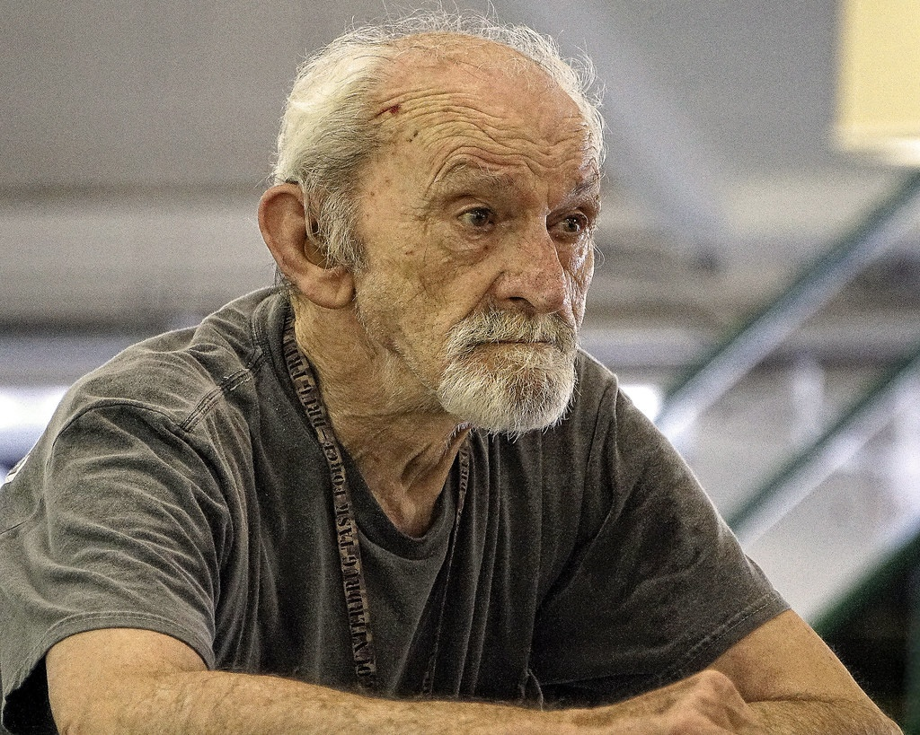
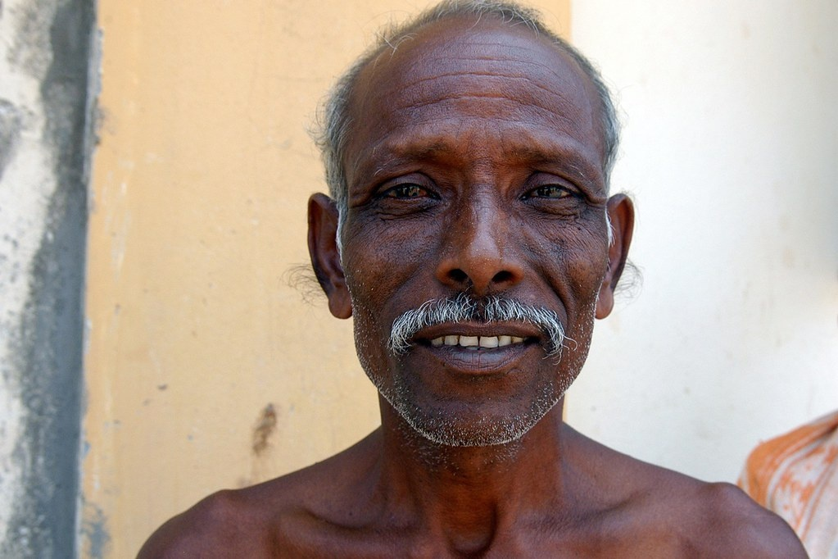
Data Sources
Face mask detection dataset on Kaggle:
https://www.kaggle.com/wobotintelligence/face-mask-detection-dataset/tasks?taskId=1123.
This dataset contains face images with various accessories, including 20 different classes. and We selected the data of the categories with and without masks to train our model.
name | x1 | x2 | y1 | y2 | classname
2756.png | 69 | 126 | 294 | 392 | face_with_mask
2756.png | 505 | 10 | 723 | 283 | face_with_mask
6098.jpg | 360 | 85 | 728 | 653 | face_no_mask
5525.jpg | 262 | 18 | 484 | 319 | face_no_mask
5525.jpg | 49 | 58 | 191 | 247 | face_no_mask
3911.png | 49 | 26 | 389 | 476 | face_no_mask
Notes:
This dataset contains face images with various accessories, including 20 different classes. and We selected the data of the categories with mask and no masks to train our model.

Slide 9
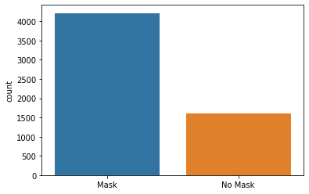
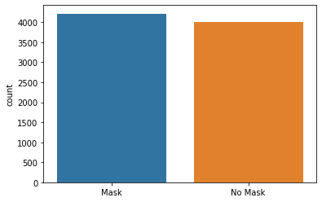
Imbalanced Data
Data Augmentation
Notes:
total number of picture in no mask category are far less than total number in with mask , this may cause bias of the model, so we decide to do some data augmentation for no mask class, including random rotation, resizing, and adding noise.
After data augmentation, we divide all image data by 255 to compress the data between 0 and 1.
and Then, randomly shuffle 10% of the balanced data to be the validation set. and use the rest of the data to train the model.

Slide 10
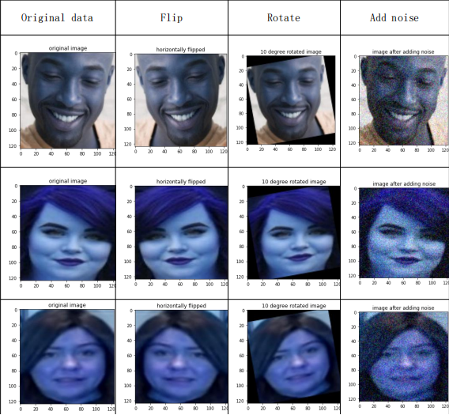
Data Augmentation
Notes:
here is some examples of augmented data.

Slide 11
Network Structure
Notes:
Hi, I am Martin, from here, let me introduce the deep neural network we used in this project.

Slide 12
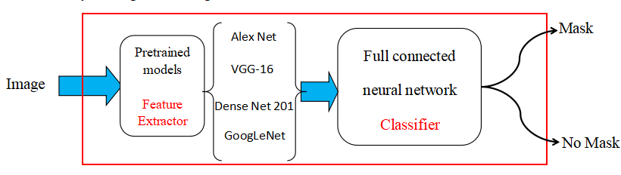
Model structure
Notes:
Training a complex deep neural network is very expensive because it requires high computing power and memory, and it is also very time-consuming. In order to save training costs, we chooses to finetune the trained model. Even when training on a small data set, this method can improve the performance of the new model to a certain extent and reduce the training time. The neural network in this system is to classify whether the input face is wearing a mask. We implemented four different most popular CNN models including: Alex Net, VGG-16, Dense Net 201 , GoogLeNet and used the pre-trained parameters. Discard all the models’ classifiers structure and add full connected neural network in order to fit these models to our goal: two classes: ‘No Mask’ and ‘Mask’, classification.

Slide 13
Model Merging
Random sample 80% of training dara
Alex Net
Mask
Random sample 80% of training dara
VGG-16
Vote
Random sample 80% of training dara
Dense Net 201
No Mask
Random sample 80% of training dara
GoogLeNet
Notes:
what’s more, in order to further improve our recognition accuracy, we use model merging to combine these four models together to make better decisions. In order to increase the diversity between models, the training data of each model is randomly selected 80% of the total training data. During merging stage, the voting mechanism is adopted, and the prediction results of each model are used for voting. The prediction results with more than half of the scores are taken as the final classification results.

Slide 14
Result Analysis

Slide 15
Model Comparison
Alex Net is best if we only care about the running time of our real time detection system.
Merged Model is best if we care about the detection accuracy.
VGG 16 is best to keep the balance between response time and detection accuracy.
 | Training accuracy | Validation accuracy | Response time(s/frame)
Alex Net | 0.9892 | 0.8645 | 0.0666
VGG 16 | 0.9847 | 0.9270 | 0.0817
Dense Net 201 | 0.9891 | 0.9479 | 0.1056
Google Net | 0.9926 | 0.9062 | 0.0895
Merged Model | ---------- | 0.9639 | 0.3434
Notes:
A successful real-time face detection system should not only have high detection accuracy, but also have low detection lags, can detect the frame image transmitted by the camera with low delay. So, to analyse the result of different models, we use three metrics to measure the quality of the models: training accuracy, validation accuracy and response time (second/ per frame). We set 10% of original data set to be validation set before training to test the model’s generalization on images which are not seen by model.
We can see from the table Merged Model has highest accuracy but needs a long time to response, which means that it can be used in scenes that do not need real-time detection but need high accuracy. Alex Net has the lowest response delay, so it is most suitable for real-time detection. Vgg-16 has the highest comprehensive ranking and can be used in different occasions.

Slide 16
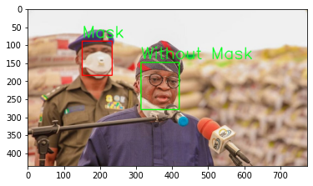
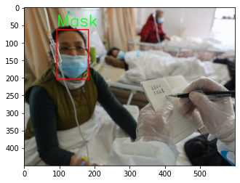
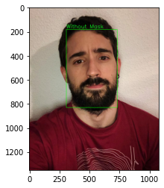
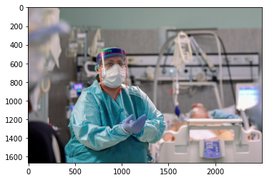
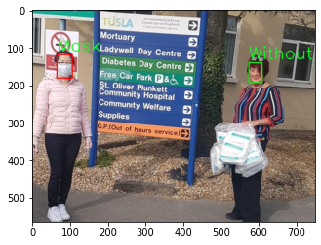
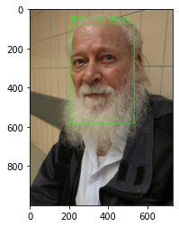
Detection result display
Notes:
So far, the whole system can run perfectly. Next, we will show some detection results of our system on the test pictures.

Slide 17
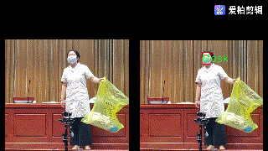
Real time video detection result
Notes:
this is the VGG-16 detection result on real time video,

Slide 18
Conclusion
In this project, we have built a high-performance face mask recognition and epidemic prevention system, which can ensure that people who enter public places and those who are already in public places wear masks. The model is trained on the face mask detection dataset on Kaggle, and the recognition rate can reach up to 96%. This system can well meet the actual epidemic prevention needs at a low cost, and has a wide range of application value and strong practical significance.

Slide 19
Future Work
In the future, we could use more diversity and complex data set to try to train the detection model. This will be helpful to increase the model’s accuracy.
We could also try use more complex object detection pre-trained modern neural networks structures like: YOLO 5, Faster RCNN, SSD. change the classification stages’ parameters to classify ‘No mask’ and ‘mask’.

Slide 20
Thank you for watching

